Slide 1
Detecting Cardiovascular disease to Minimize Medical Cost
Darwin Project
Jiayan Han | Hassan Sheikh | Bo Yu | Shimin Zhang

Slide 2
Table of Contents
1
Current Situation
01
2
Business Question
04
3
Data Mining Approach
06
4
Method Setup
09
5
Results
13
6
Learning from Model
22

Slide 3
Cardiovascular disease in the U.S.
17.9M
People die each year from CVDs
31%
Of all deaths worldwide
85%
are from heart attacks and strokes of those deaths
01

Slide 4

And that is costing a fortune
$19,000
Per Year
Per Person
in annual medical costs
Medical costs of Coronary Heart Disease increases
100% by 2030
02
Notes:
Assuming someone is diagnosed with Diabetes at the Age of 50. They are expected to live to 76, which is approximately 26 years. At $7,900 per year, a diabetic would cost $205,400.

Slide 5

A prevention plan can save millions
$2,580
for prevention could prevent diabetes
The net present value of the prevention plan cost per person is
$41K
03
Notes:
7300*.7

Slide 6
Business Question
Who should receive this program??
04

Slide 7

Data
2,3000 Records
Of which, roughly 5,000 are high risk (21.7%)
Data Source
05

Slide 8
Data
Physical Characteristics:
Weight
Height
BMI
Age
Gender
Blood component:
SBP
DBP
06

Slide 9



Methodology
Step 1
Clean
Step 2
Segment
Step 3
Model
08

Slide 10
Data Segmentation
Balance target value: After we cleaned data, we found the ratio between Non-HR and HR is around 1:2, which makes it hard to build a meaningful model, so we decided to balance the target values.
11

Slide 11





Data Segmentation
Training data with different target ratio
( rows)
Same testing data with original target ratio
( rows)
1:1
1:2
1:3
1:4
1:19
12

Slide 12
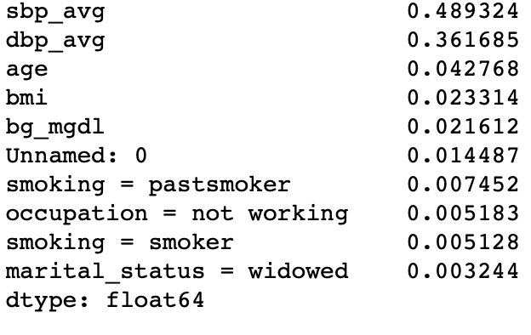
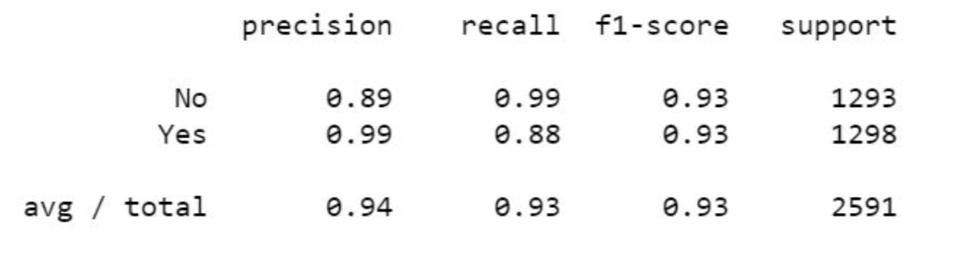
Results
Prediction for test dataset
Most important features
19
Notes:
Result from test data

Slide 13
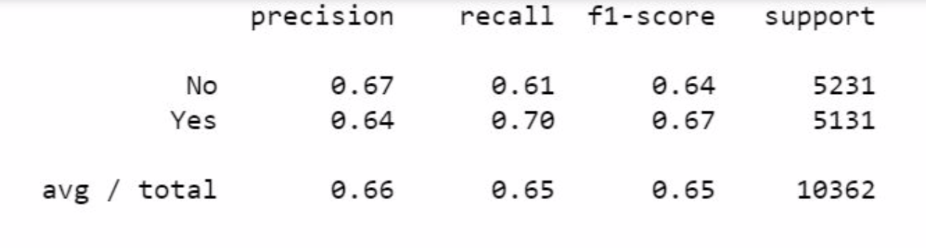
Results
19
Notes:
Result from test data

Slide 14
Cost Matrix
Assumptions
Cost in different situations
Average Diagnosis Age | 55
Physical Examination | $200
Prevention Medication | $1,000
Insurance | $1,380
Nutritional Consulting | $1,000
Annual Costs to treat for Cardiovascular | $19,000
Predicted as High Risk | Actual High Risk | Cost ($)
Yes | Yes | 2,580
Yes | No | 200
No | Yes | 19,000
No | No | 0
19

Slide 15
How the program impacts costs
 |  | Predicted
 |  | HR | Non-HR
Actual | HR | $2,580 | $19,000
 | Non-HR | $200 | $0
20

Slide 16
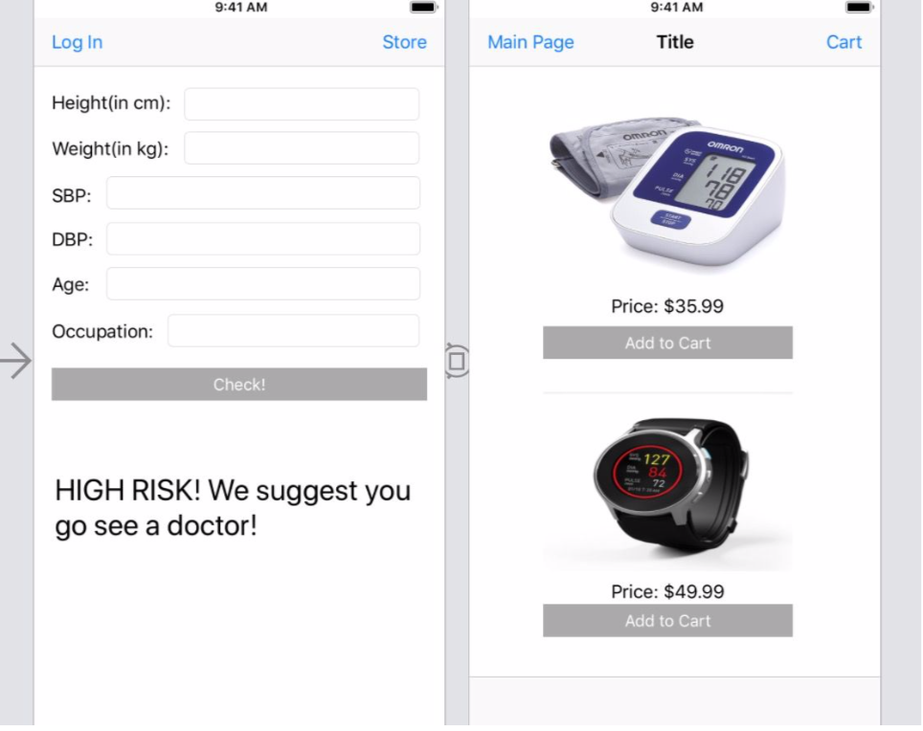
Next Step
36

Slide 17
Reference
https://www.bluecrossma.com/blue-iq/pdfs/TypicalCosts_89717_042709.pdf
https://www.womenshealthmag.com/weight-loss/a19977865/hiring-a-nutritionist/
https://www.nytimes.com/2016/03/19/your-money/insurance-for-critical-illness-adds-security-but-at-a-cost.html
36

Slide 18
Questions
37

